Slide 1
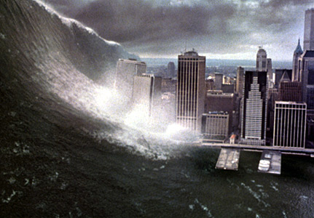

Slide 2
SUBSTITUTING EXISTING FEDERAL/STATE/LOCAL CONTROL AND MANAGED HOMELAND SECURITY SERVICES WITH REGIONAL GOVERNANCE: A PUBLIC CHOICE APPROACH
Drs. Simon Hakim & Erwin A. Blackstone
Dept. of Economics & Center for Competitive Government
Fox School of Business, Temple University
hakim@temple.edu

Slide 3
The Problem
Global warming, and a rise of extreme religiously related terrorism have already raised and are expected to yield severe disasters.
Government led preparation, response, and recovery efforts from natural and manmade disasters appeared to have failed or had limited success.

Slide 4
Interdisciplinary Sources
Public Choice
Public Administration
Regional Science
Homeland Security
Notes:
The academic field of public choice explains why leaders in government often behave in a manner that maximizes their own interest which may not coincide with either government or social interests, thus yielding social ineffient outcomes.

Slide 5
Reasons for Social Inefficient Behavior
1. Short term view
Immediate success to satisfy the public. Visible services tend to be over-funded while longer term success like HLS tend to be under-funded. Examples include fortifying levies in New Orleans, and under-funding pensions and retiree healthcare.

Slide 6
Reasons for Social Inefficient Behavior
2. Type 1 and 2 errors
Type 1 error is when a risky action is taken and turns out to be undesired. As such public officials are blamed. Type 2 action is when no action is taken and people get hurt, however officials cannot be easily blamed. Everyone observes when a mistake is done while avoiding a risky action is less noticeable and blame cannot be easily attributed. Thus, officials are risk averse and avoid type 1 errors. Example, delaying summer evacuation when a hurricane is expected at low probability.

Slide 7
Reasons for Social Inefficient Behavior
3. Visibility and political gain
Both elected officials and bureaucrats allocate resources on visible activities that benefit constituents and glorify them while minimizing spending on homeland security activities that may yield higher net social benefits.

Slide 8
Reasons for Social Inefficient Behavior
4. Tragedy of the commons
Markets may result in levels of protection against disasters that are below their own private values. As more private infrastructure companies participate in any local market, competition stiffens, and more resources are shifted from non-immediate functions to satisfy short term efficient production needs that lower costs. Competition forces firms to lower costs and shift resources from research and development and security to direct marketing and production

Slide 9
Reasons for Social Inefficient Behavior
5. Unpredictable impacts of disaster
Public decisions about spending on homeland security should depend on social cost-benefit findings that include external costs. Private infrastructure companies base their spending on security mainly on private costs and benefits that accrue to them in disaster while under estimating external costs. Also, the risk or the probability of a disaster occurrence is often unknown which further yields cost estimated to be inaccurate. Thus, both public and private entities cannot determine the correct spending on security.
Notes:
Public decisions about spending on homeland security should depend on social cost-benefit findings that include external costs. Private infrastructure companies base their spending on security mainly on private costs and benefits that accrue to them in disaster. The problem is that the risk or the probability of a disaster occurrence is unknowable and the estimate of costs is often inaccurate. Thus, both public and private entities cannot determine the correct spending on security. In such circumstances, it is understandable that decision-makers are reluctant to spend on security. For an unknowable event, local governments are often hesitant to invest while the federal government is arguably likely to take more appropriate action

Slide 10
Reasons for Social Inefficient Behavior
6. Moral Hazard
When private infrastructure managers expect the federal and state governments to compensate them for damages resulting from a disaster, they undertake fewer or less precautions than is socially appropriate. The same is true for localities that underspend on security expecting state and federal governments to defray damages if a disaster occurs. Prescott and Kydland (1977) suggest that rational actors take into account future government actions in calculating their long term present value. For example, government could announce that it does not support protection against floods in a specific floodplain. However, private contractors will build in the area knowing that once buildings are erected, government will protect them in spite of past announcements. Thus, current decisions become suboptimal because government will respond to de-facto future situations.

Slide 11
Reasons for Social Inefficient Behavior
7. Information and Preference Revelation
Since victims receive from government free assistance and monetary payments for losses, they have incentive to inflate the amount requested. In practice, since the claims are managed by insurance companies and in many cases are assigned to independent adjusters who are often paid a percentage of the claims, the approved amounts are likely to be inflated.

Slide 12
Reasons for Social Inefficient Behavior
8. Government Bureaucracy
The large size and multiple bureaucratic levels of government, and perceived zero marginal cost of their workers makes the approval process for funding and supply cumbersome and time consuming for both response and recovery efforts. This complex process for approval of activities that traverses through several individuals makes obstruction easy and is referred to as “the Tragedy of the Anti-Common.” In large bureaucratic corporations, this phenomenon of difficult approval for action has been called the problem of the “abominable no-man.” This phenomenon is common for most large organizations that enjoy monopolistic power. In large business and government entities, executives experience lack in managerial control due to information lost in a multilevel managerial hierarchy. As such, these entities experience diseconomies of scale in comparison to smaller entities with flatter hierarchy where information is easier transmitted, and thus their executives maintain greater grasp of the operation. (Canback, 2006.) Bureaucracy in multilevel large entities often contributes to rigidity in behavior and performance.

Slide 13
Reasons for Social Inefficient Behavior
9. Overlapping Jurisdictions
Local, state, and special districts often overlap in their responsibilities over the same critical infrastructure (CI). The fragmentation and overlapping jurisdictions to secure and maintain CI like levees in New Orleans enabled each agency to avoid its responsibility.

Slide 14
Reasons for Social Inefficient Behavior
10. Peak load problem
Police, fire and medical services are designed in size and content for their normal and not for unforeseen disaster time demand. The common unresolved problem is that when a disaster occurs at often unpredictable time and scope, the demand for public emergency services increases beyond existing capacity. Under the prevailing framework, state and federal agencies provide the necessary resources when disaster occurs at zero prices.

Slide 15
Reasons for Social Inefficient Behavior
11. Monopoly Inefficiency
All three levels of government often have insufficient resources at times of disaster. However, such resources are typically available in the region with private or other public jurisdictions that could be easily mobilized with early or advance preparation. Also, government, like business monopolies or dominant firms in general, are slow to innovate, often waiting for another firm to innovate and if the innovation proves successful, the monopoly firm then copies the innovation and sometime even supplants the innovating firm.

Slide 16
Reasons for Social Inefficient Behavior
12. Low probability-high cost event
Executives in both the public and private sectors consider the expected costs realized to their entity in their decision whether and how much to invest in preventive activities. The expected cost is the multiplication of the perceived probability of a disaster by the cost that will be realized if it occurs. There are several reasons for favoring investment in high probability adverse event rather than in a lower probability similar such event when both investments yield the same reduction in the expected costs.
Notes:
There are several reasons for favoring investment in high probability adverse event rather than in a lower probability similar such event when both investments yield the same reduction in the expected costs. First, executive tenure is relatively short and therefore they tend to favor investment in high probability event even if the expected costs are less than that of the lower probability event. The second reason is, again, the moral hazard phenomenon. When a low probability-high cost disaster occurs the federal government will aid in the relief and recovery efforts. Thus, it is personally more rewarding for the executive to invest in the high probability-lower cost event even if the spending on the former is cheaper for the same expected costs. Indeed, an empirical study showed that expected government support resulted in lower private spending on security. A third reason for avoiding investment in low probability event is that the probability is low already and further reduction in that probability is not perceived as valuable. A fourth reason is that public executives consider the social costs which also include negative externalities while private executives consider only the private costs. Thus, for the same event private firms will underinvest relative to the socially desired amount. It is important to note that the level of risk and therefore the expected costs are difficult to determine

Slide 17
Could Adverse Effects
Be Mitigated
Theory and experiences suggest 6 factors that address the above stated problems, and will serve to develop our organizational model:
Regionalization
Leadership
PPP
Volunteers
Exposure to market forces
Flat hierarchy for control and management

Slide 18
Our Model
From above: FEMA plays a dual role assisting localities in the event of a declared national disaster. It provides both funds and services for response and recovery efforts. Equipment and Services from its own warehouses or purchased in open markets are provided at a zero price. 3 reasons for FEMA’s inefficiencies: monopolistic stance, lack of onsite information, and the dual role it holds.

Slide 19
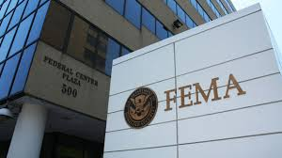
Our Model
FEMA will concentrate just in funding
Funding as lump sum amount of opportunity costs
Standards for compensation
Shifting production & supply to competitive regional counsels.
Notes:
Andards for

Slide 20
Our Model: Regionalization
Transfer responsibilities and control from federal, state, and local public entities to a regional council
Create regional supplies and labor registry, and warehouses
Bidding for capital, labor & supplies rendered at disaster time at predetermined competitive prices.
Most goods & services will be provided in a monopolistic competitive type markets where private, public, volunteer entities could bid.

Slide 21
Our Model: Regionalization
Flexible borders for the regional council. Could cross state lines. The council could address the impacted region.
Regional council for HLS be established just for high risk regions.
Council composed of regional stakeholders relevant for preparation, response and recovery efforts
Registry & pre-contract for labor & capital
Regional emergency warehousing.

Slide 22
Our Model: Management
Public-Private-Volunteers Partnership
Council is in charge of all preparation, response, and recovery efforts.
Regional resident leader. Preferred a volunteer.
Power in selecting core managers.
In emergency, controlling power on existing local governments.
The council assumes full emergency control on the impacted region, and services that are usually performed by individual jurisdictions.
Flat hierarchical structure with great decision making power to front volunteers/workers.

Slide 23
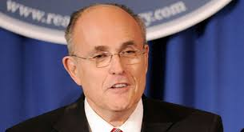
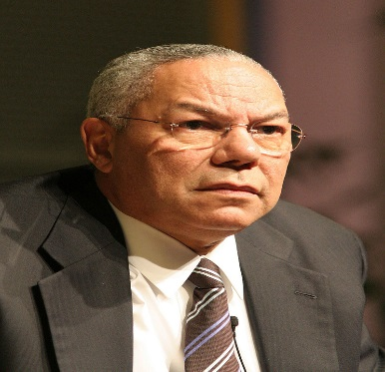
Our Model: Leadership
A leader residing in the region with successful experience in leading a large public or private enterprise preferable managing crises situations.
A volunteer who chooses to contribute to society, and could attract other mid-level executives to join the “club.”
Long term commitment for preparation, response and recovery activities.
Serves on both capacities of chairing the board and presiding the management team. Assumes government leadership power in emergencies.

Slide 24
Our Model: Equipment
Peak time demand. Excess demand at disaster
Resources are available within the region and vicinity.
Registry. Public & private resources. Prior bidding.
Regional warehouses.
Early protocol for action at disaster time.

Slide 25
Our Model: Labor-Existing Conditions
Peak time demand. Excess demand for emergency personnel beyond peacetime public capacity.
Experience shows that many public emergency personnel are absent at time of disaster helping their family.
Need for semi skilled personnel with basic training.
National data show more than 3 times more private security guards than federal, state and local law enforcement personnel, are mostly idle at disaster.
Emergency personnel (e.g. medical) is idle at time of disaster and available for public use (Late Mayor Menino’s initiative in Boston).

Slide 27
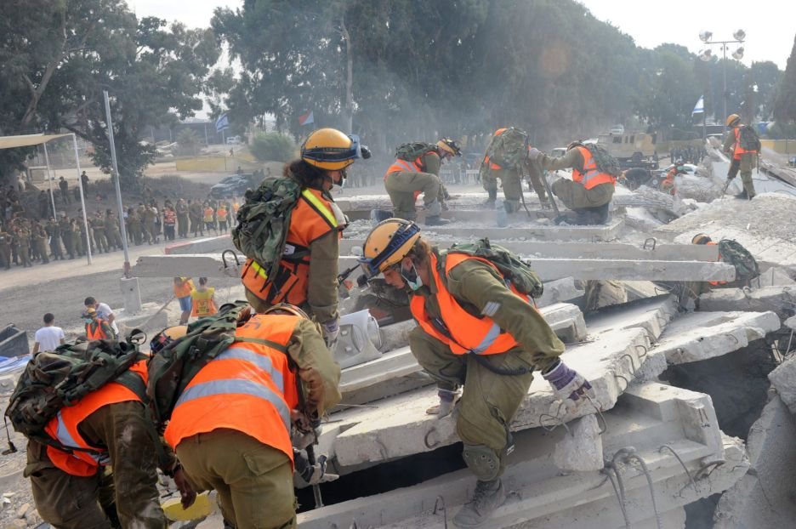

Slide 28
Our Model: Labor
Train, assign, and pay personnel for emergency peak time demand situations. Included, private security guards, all medical personnel for neighborhood centers (e.g. Boston), drivers, mechanics, and IT operators.
Use of the region’s labor supply may yield lower social cost than the employment of the National Guard. Possibly deputize temporary key security guards who fulfill police tasks.
Recruit, train, and assign in advance volunteers. Limit “on the spot” volunteers unless especially needed (e.g. medical personnel.)
Volunteers can be signed up at colleges and universities, churches and fraternal organizations, retiree, and emergency response groups.

Slide 29
Four Keys For Success
The CEO under the auspices of the Council controls the entire homeland security budget and is not dependent on various political jurisdictions for funding.
The Council replaces other political jurisdiction on all homeland security issues and is not created as an additional layer.
Allowing the Council to keep their savings. The incentive to save and use the extra resources to enhance homeland security services in the region encourages innovation and efficient use of resources as evident in other competitive markets.
Selection of a champion to head the operations of the Council. The champion should be a successful leader who is not subjected to political or narrow business pressure, and is financially secure. Public Private Partnerships usually improve efficiency of service delivery over that of monopolistic government.

Slide 30
Market Orientation
Regulation that requires CI to insure for direct and external costs of a disaster. Insurance policies for homeland security require various deductibles that allow the insurer to encourage some preventive activities.
Insurance companies will design how to reduce risk exposure and discounts that could encourage mitigating activities by CI owners. Competition among insurance companies will lead to efficient incentives and pricing of preventive activities. Thus, competitively inspired insurance planners and inspectors might replace monopolistic government spending and imposition of regulation compliancy.

Slide 31
Summary
A disaster is an event with low probability of occurrence, but if it occurs the expected costs are high. Thus, public & private policymakers underspend on preventive activities.
Asymmetric information between terrorists and security forces usually makes highly effective protection difficult or very costly.
This study identifies enhancement of PPP by volunteers, shifting responsibilities from all three levels of government to a flexible regional entity that relies on existing resources, and most importantly selection of a person with proven entrepreneurial skills to lead the preparation, response and recovery efforts.
Government actions are influenced by individual interest that could deviate from those of the community. Introducing competition to the often monopolistic government production and greater involvement of corporate executives in the production of public goods improves efficiency.

Slide 32
Summary
Shifting HLS control & management from divisible federal/state/local government to regional council.
Introduction of competition, volunteers, and independent and entrepreneurial leaders while reducing the role of government will enhance control and management of disasters and most importantly introduce incentives for managerial and technological innovations.

